Slide 1




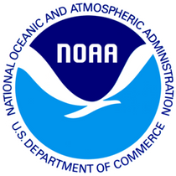

Presentation Title
Presented by: Name, Title | Organization
oceanenterprise.com

Slide 2

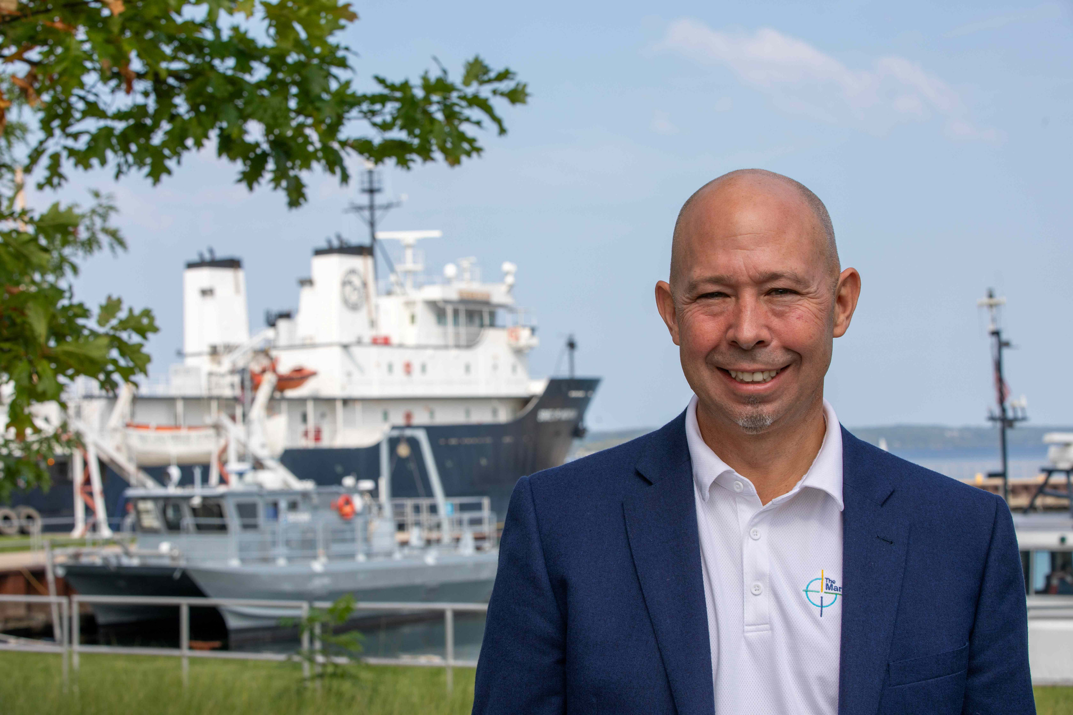
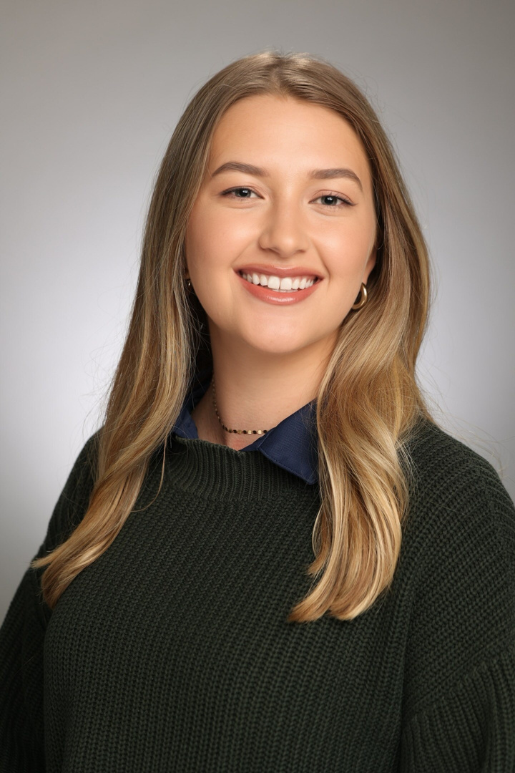
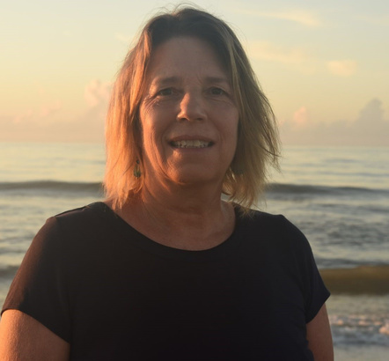
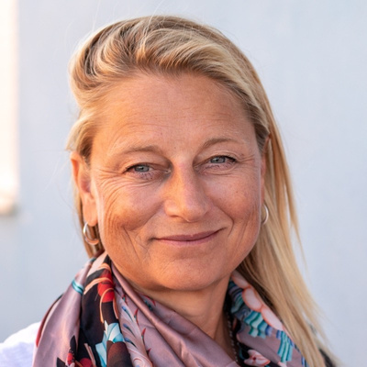
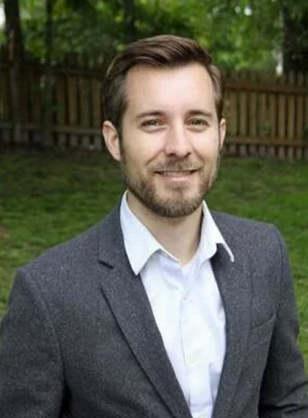
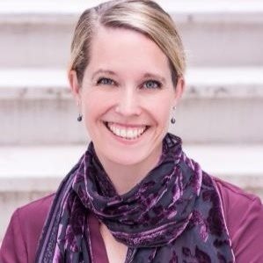
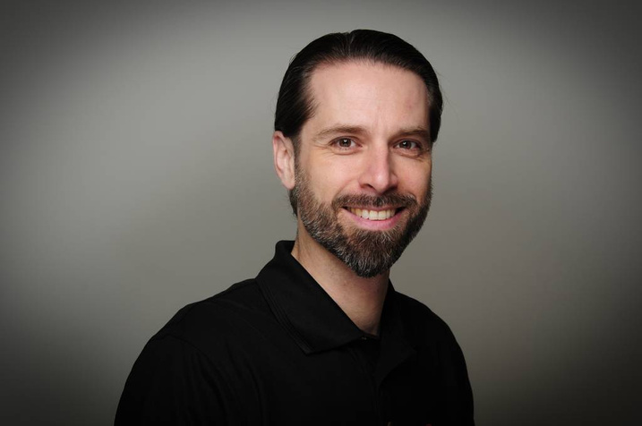
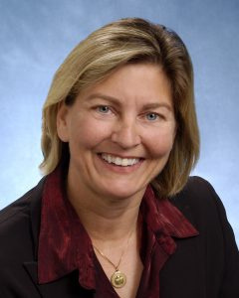
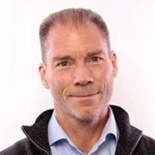
Executive Team
Zdenka Willis
Emma Heslop
Zack Baize
Jessica Snowden
Title?
Program Specialist,
Global Ocean Observing System (GOOS), IOC/UNESCO
Program Manager,
NOAA Blue Economy Program
Deputy Director,
Global Ocean Monitoring & Observing, NOAA/OAR
Hans VanSumeren
Caisey Hoffman
Senior Director, Ocean Enterprise Initiative
Manager, Ocean Enterprise Initiative
Peer Fietzek
Donna Kocak
Patrick Gorringe
Senior Business Development Manager Ocean Science, Kongsberg Discovery
Fellow, Senior Scientist Innovation Strategy Lead, L3Harris
Manager International Ocean Relations, SMHI

Slide 3
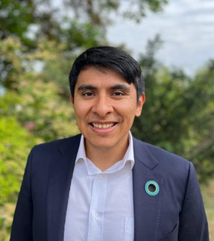
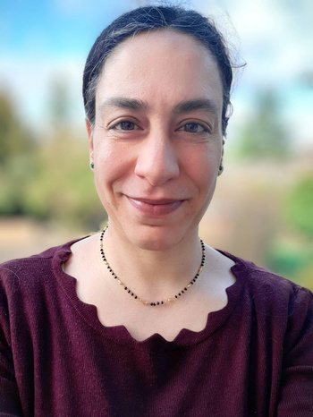
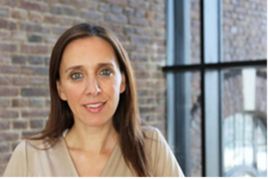
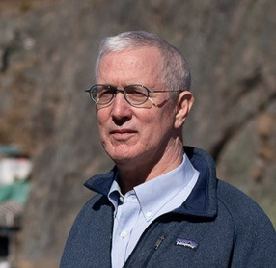
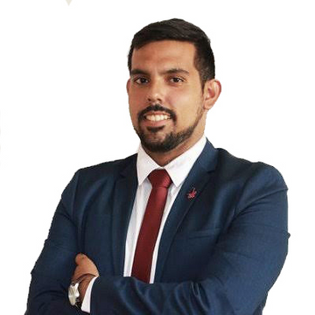
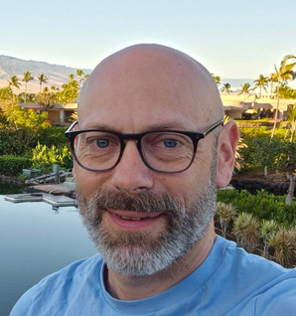
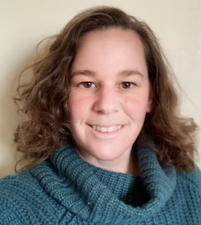
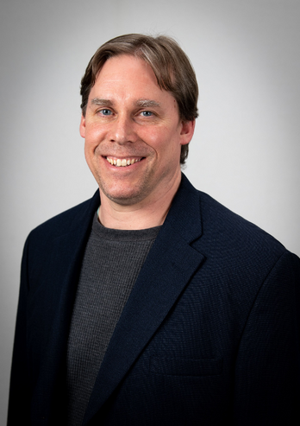
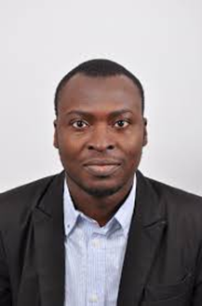
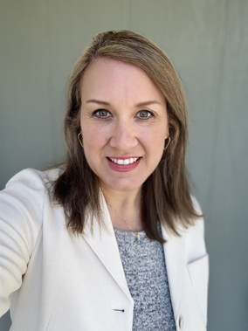

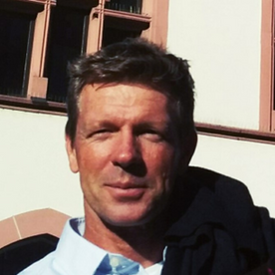
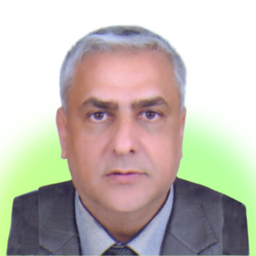
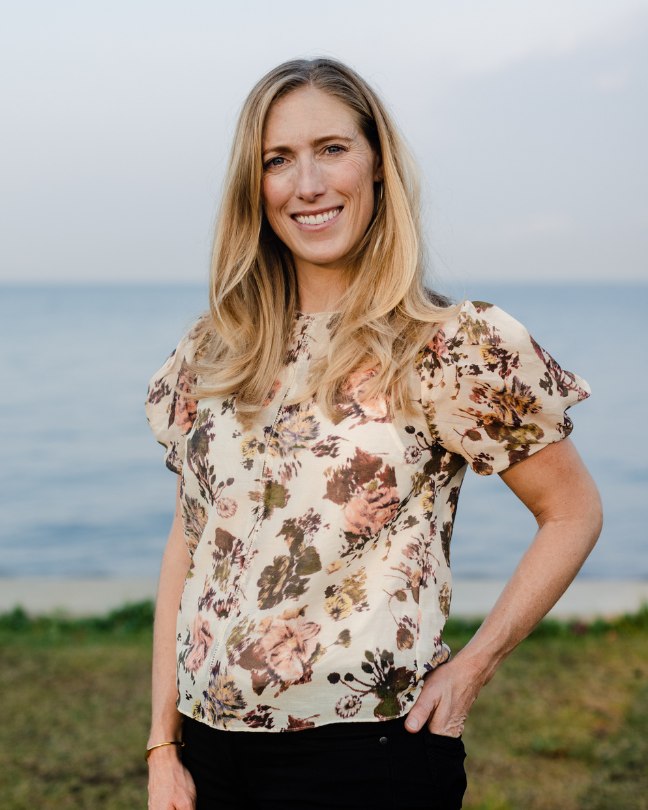
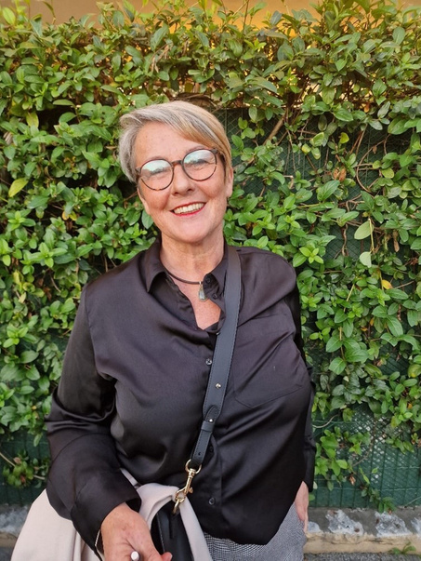
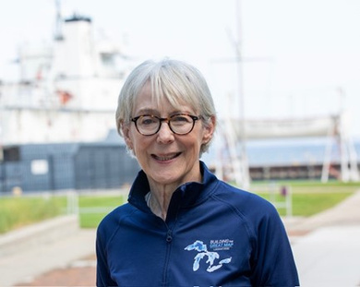
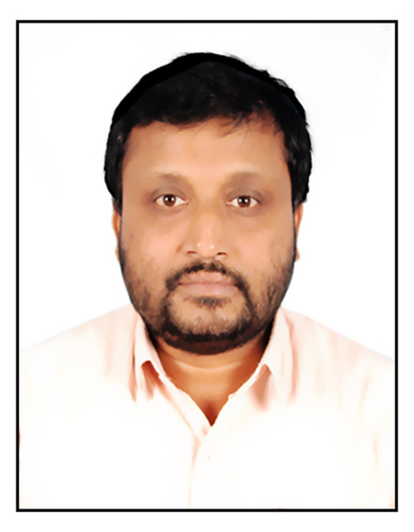
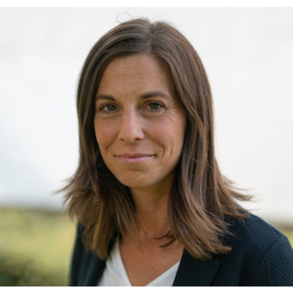
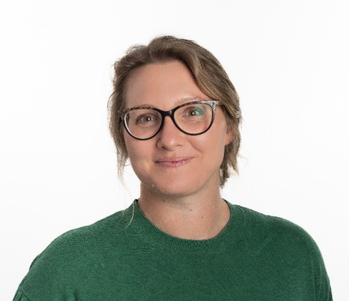
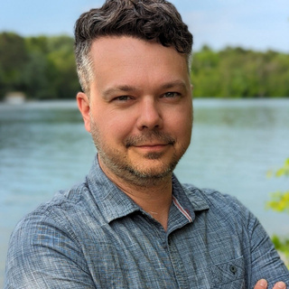
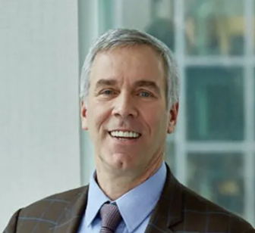
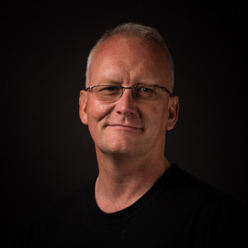
External Advisory Team
Alfredo Giron Nava, Ph.D.
Anuscheh Nawaz, Ph.D.
Aspasia Pastra
Brad deyoung
Carlo Angeles
Christopher Whitt
Corinne Bassin
David P. Keller, Ph.D.
Head of Ocean, World Economic Forum | Head of Friends of Ocean Action
Principal Research Scientist/Engineer, Affiliate Assistant Professor Mechanical Engineering, University of Washington - Applied Physics Laboratory
Assistant Professor, Global Ocean Institute of the World Maritime University, Sweden
Executive Director CIOOS Pacific University of Victoria Professor Emeritus Bartlett Professor of Oceanography Memorial University
Executive Director | The Amazon Pledge
Senior Engineering and Safety Consultant | Lloyd's Register Foundation
Head of Data Solutions | Schmidt Ocean Institute
Director of Research and Technology | Carbon to Sea Initiative
Isa Olalekan Elegbede, Ph.D.
Holly Woytak
Somorin Ifeoluwa Abolade
Jochen Klinke, Ph.D.
Dr. Karim Hilmi
Kate Danaher
Michele Barbier, Ph.D.
Millicent (Milli) Pitts
Head of Research and Innovation @ Saeio Global, Fellow of the Future Earth Coasts (FEC), Deputy Chair, IUCN CEESP Governance, Equity and Rights Theme
Business Development | GIS Analyst | Fugro USA Marine, Inc.
Maritime Lawyer and Ocean Governance Expert
Director of Science at Sea-Bird Scientific
National. Institute of Fisheries Research (INRH-Casablanca) Morocco
Managing Director | Oceans Investment Team | S2G Ventures
Inria Center of Université Côte d’Azur, Ethics Advisor of EU funded projects
Executive Director | Ocean Exchange
Nair Balakrishnan (Bala), Ph.D.
Nele Dageförde
Ruth Patterson, Ph.D.
Scott Loranger, Ph.D.
Ted Janulis
Todd Kleperis
Group Director and Scientist, INCOIS, India
CEO | TransMarTech (TMT)
Adjunct Research Fellow, Charles Darwin University Environmental Services Business Unit Lead, Oceanographer
Acoustician and Applications Scientist - Kongsberg Discovery - Ocean Science
Founder & Principal | Investable Oceans
Founder | Tekmara

Slide 4
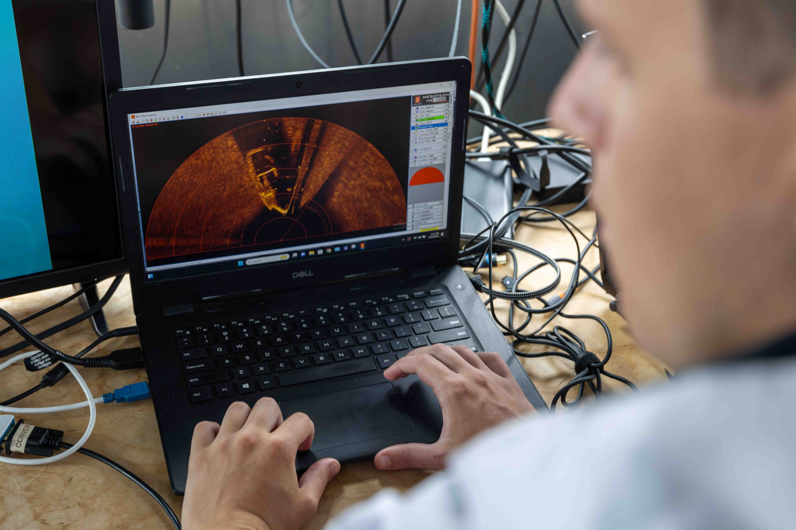
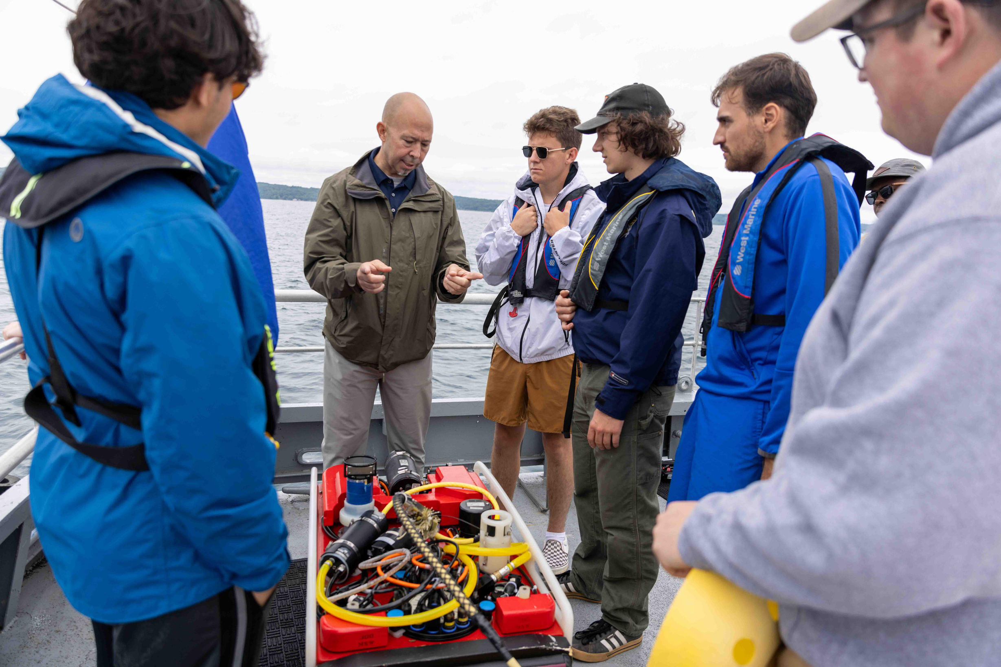
Vision Statement
A flourishing Ocean Enterprise that is recognized as an integral market sector, grows a sustained ocean observing system, and changes the perception of ocean information from peripheral to essential to society.
Mission Statement
Grow the ocean observing system through better public-private partnerships by creating a globally inclusive forum to understand market opportunities, incentivize ocean solution innovation, facilitate data and information exchange, develop a workforce, and proliferate scalable technology to achieve benefits for all stakeholders of the Ocean Enterprise.

Slide 5



Foundational drivers needed to sustain public/private partnerships in support of bolstering the Ocean Enterprise.
Foundational Drivers
Essential Service
Visible Enterprise
Distinct Market
A robust Ocean Enterprise recognized as essential to lives and livelihoods; ocean knowledge, products, and services are no longer considered peripheral.
The Ocean Enterprise is visible, identifiable, and recognized as a strong contributor to the global Gross Domestic Product (GDP).
The ocean observing products and services sector is identified as a distinct market sector that attracts investment.

Slide 6
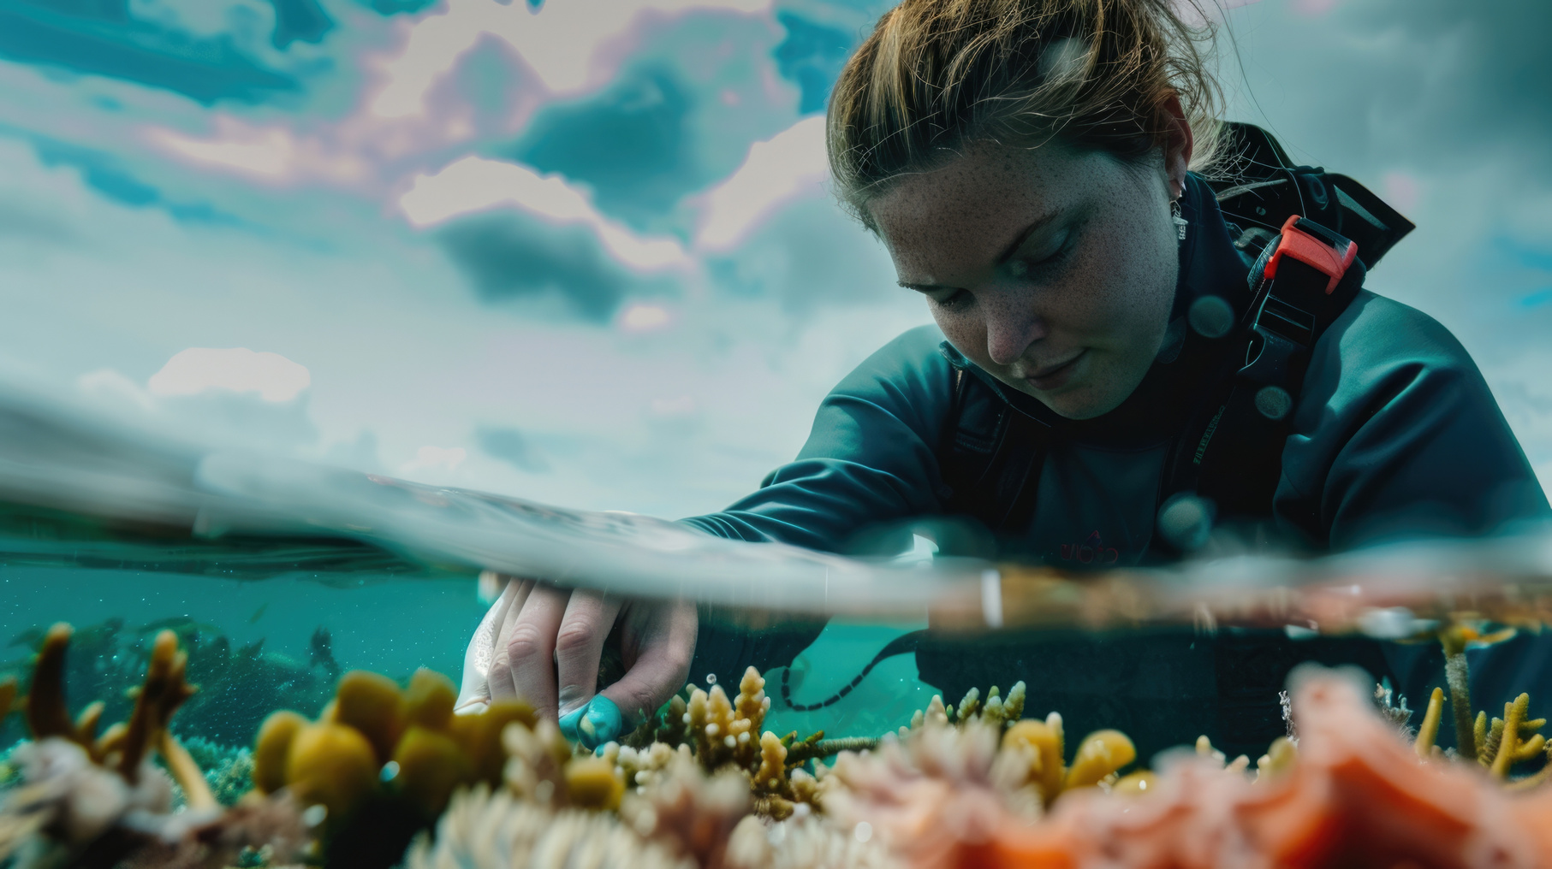
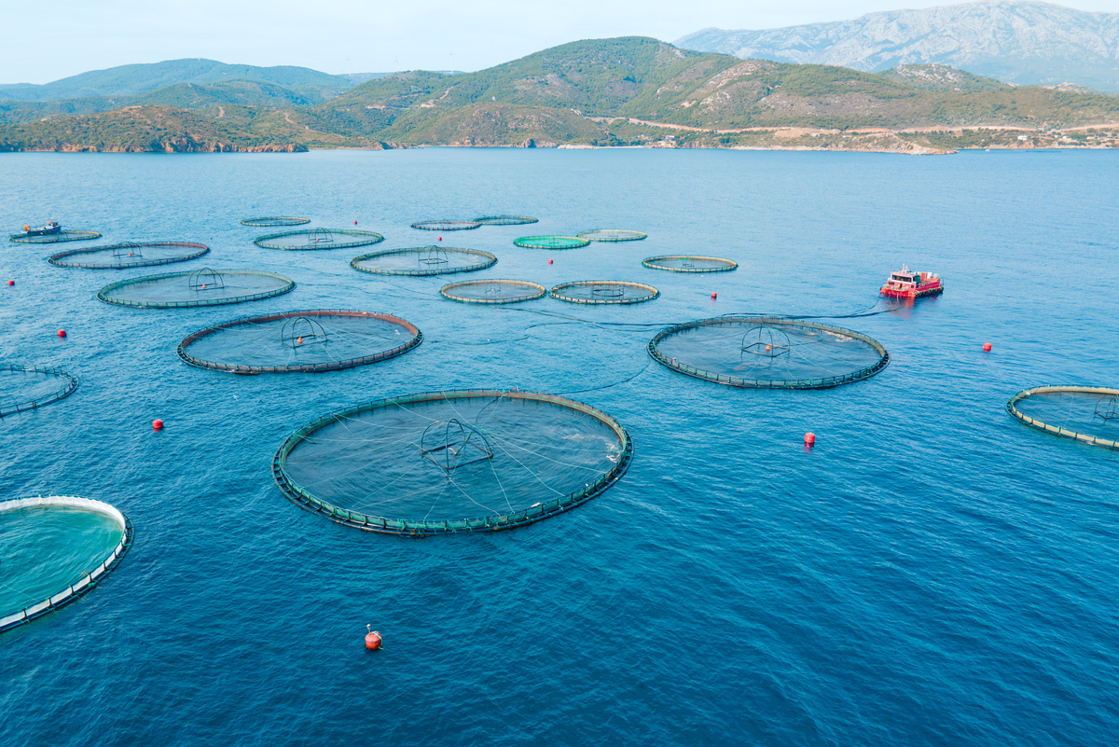
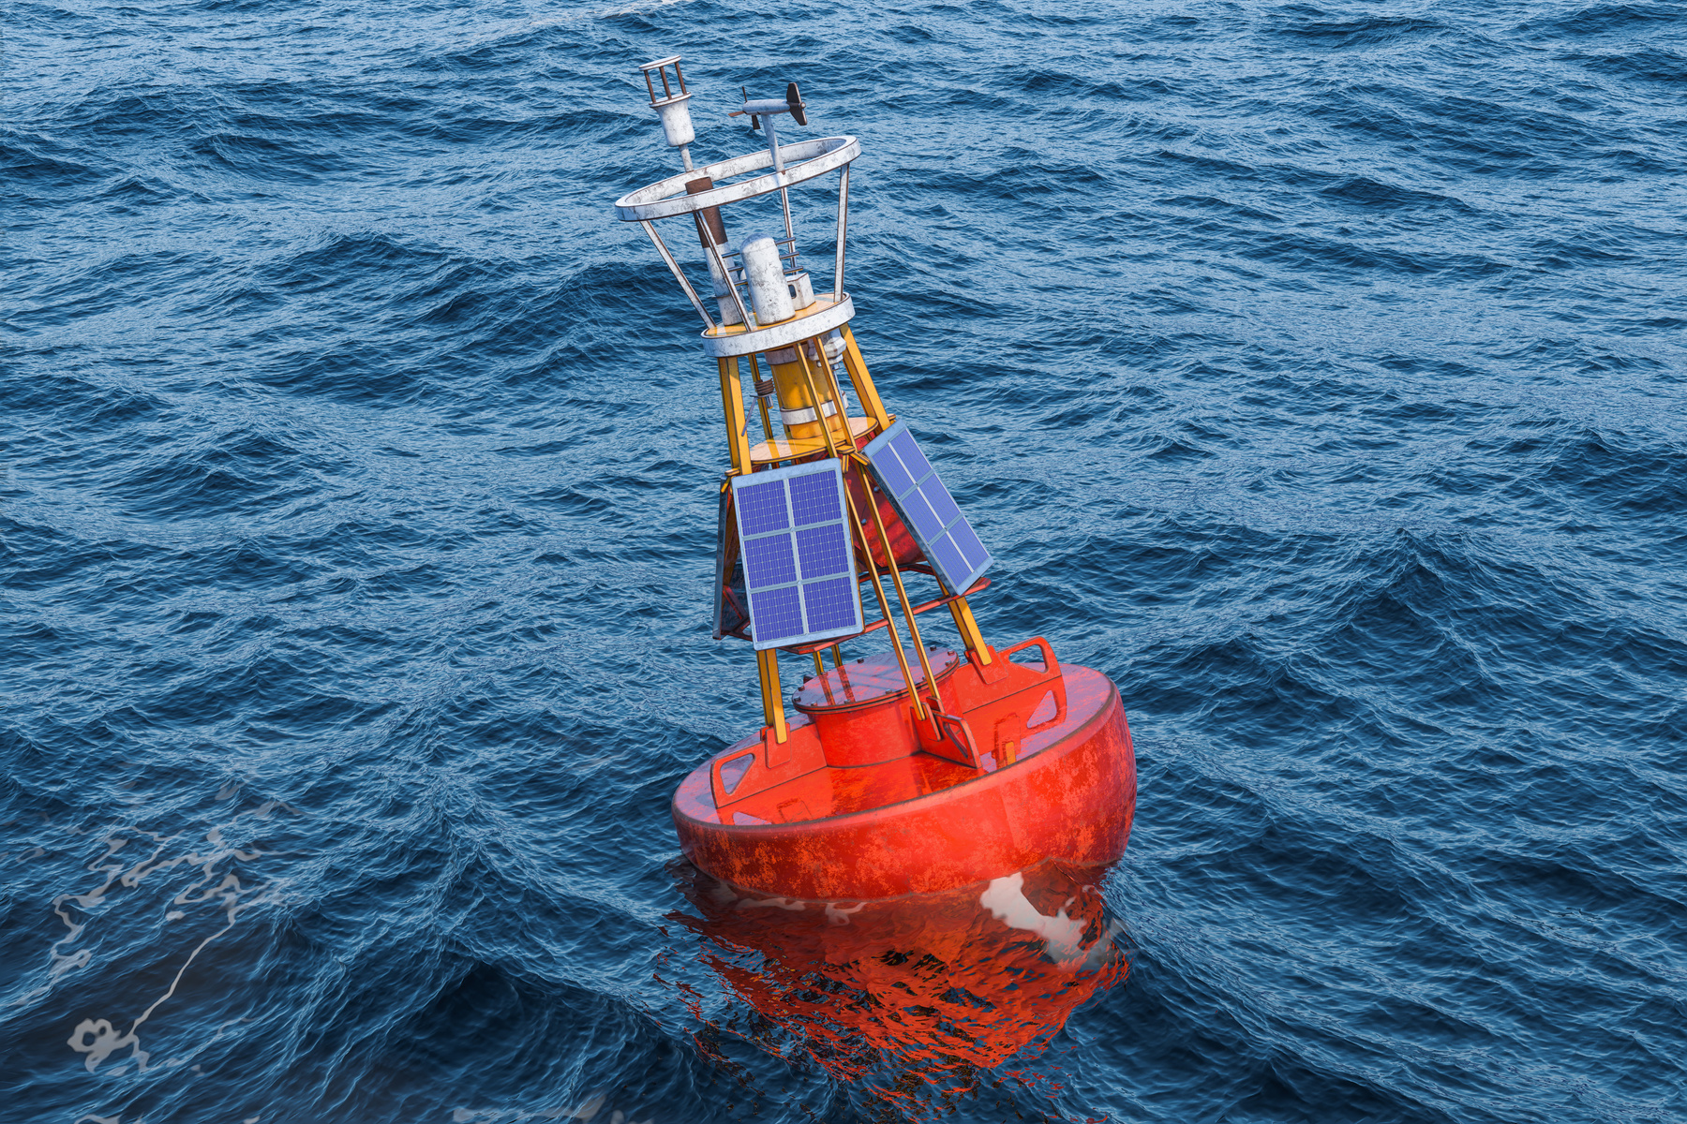
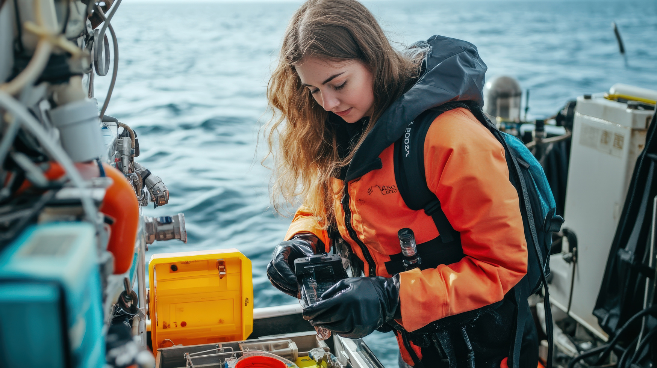
What is the Ocean Enterprise Initiative?
+ A flagship program that aims to spearhead innovation, thought leadership, and economic development within the Ocean Enterprise.
+ The Ocean Enterprise Initiative is the expansion of the signature program Dialogues with Industry, launched in 2022 with partners from GOOS, NOAA, and industry partners.

Slide 7
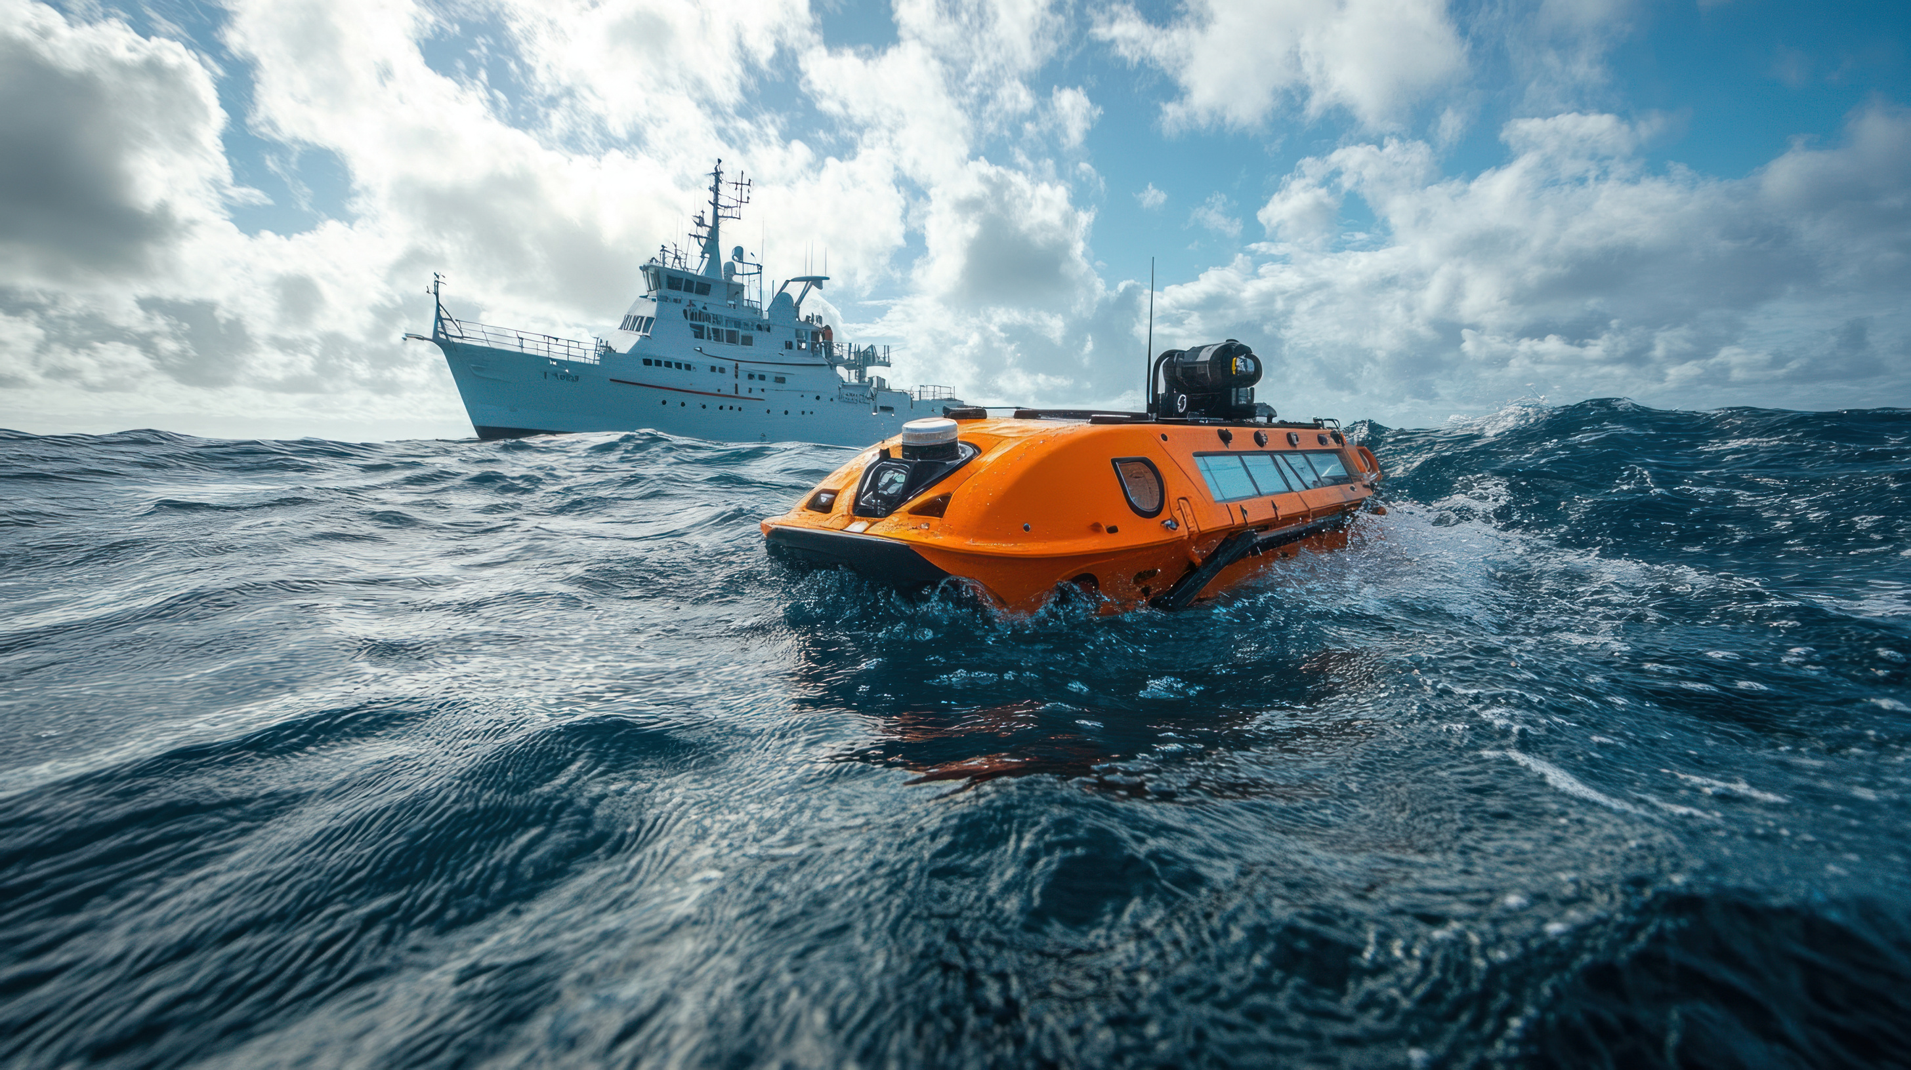
Program Plan
+
+
+
+
+
Grow a vibrant Ocean Enterprise business cluster.
Sustain a robust ocean observing system.
Support NOAA’s Ocean Enterprise Accelerator Program.
Improve market visibility and aggregation of demand.
Support recruitment and training of the next generation workforce for the blue economy.

Slide 8
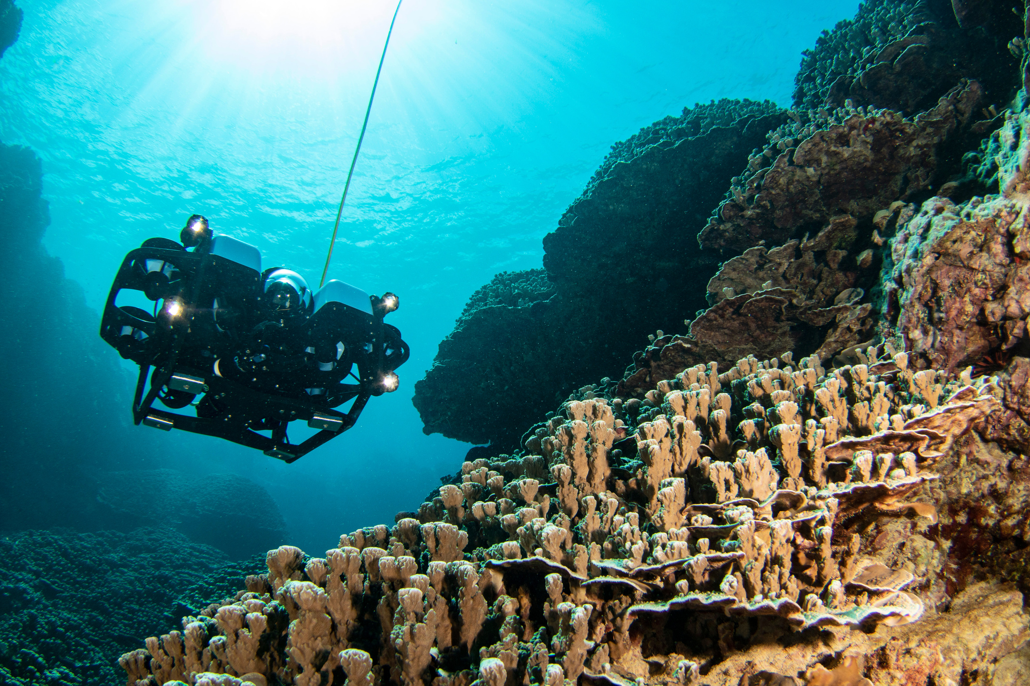





Opportunities:
US blue workforce growth from technician to engineers and scientists.
Increased US manufacturing supporting new technology development.
Increased private investment and new business development.
Dual use of observing data for defense/commercial and public consumption
Ocean observing innovation benefits all market segments, and businesses can exploit them commercially.

Slide 9
Slide Title
+
Sub Title
+
Sub Title
Sub Text
Sub Text
+
Sub Title
+
Sub Title
Sub Text
Sub Text
+
Sub Title
+
Sub Title
Sub Text
Sub Text

Slide 10
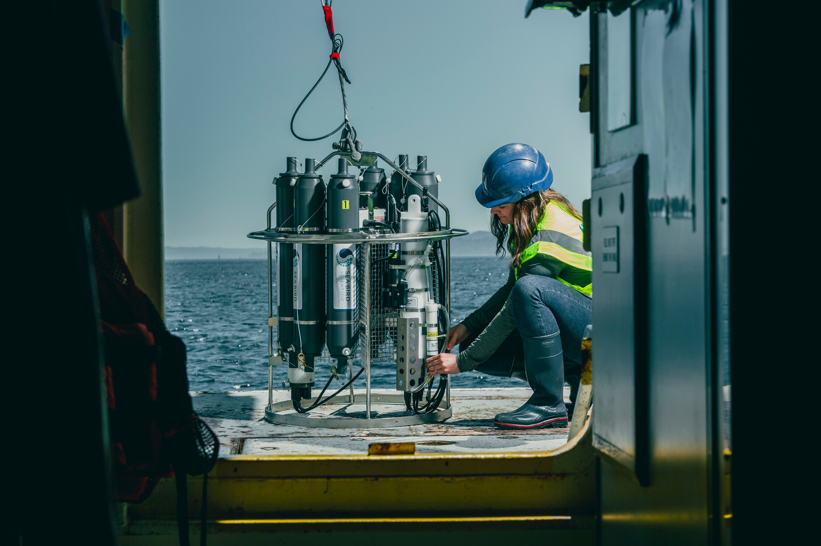
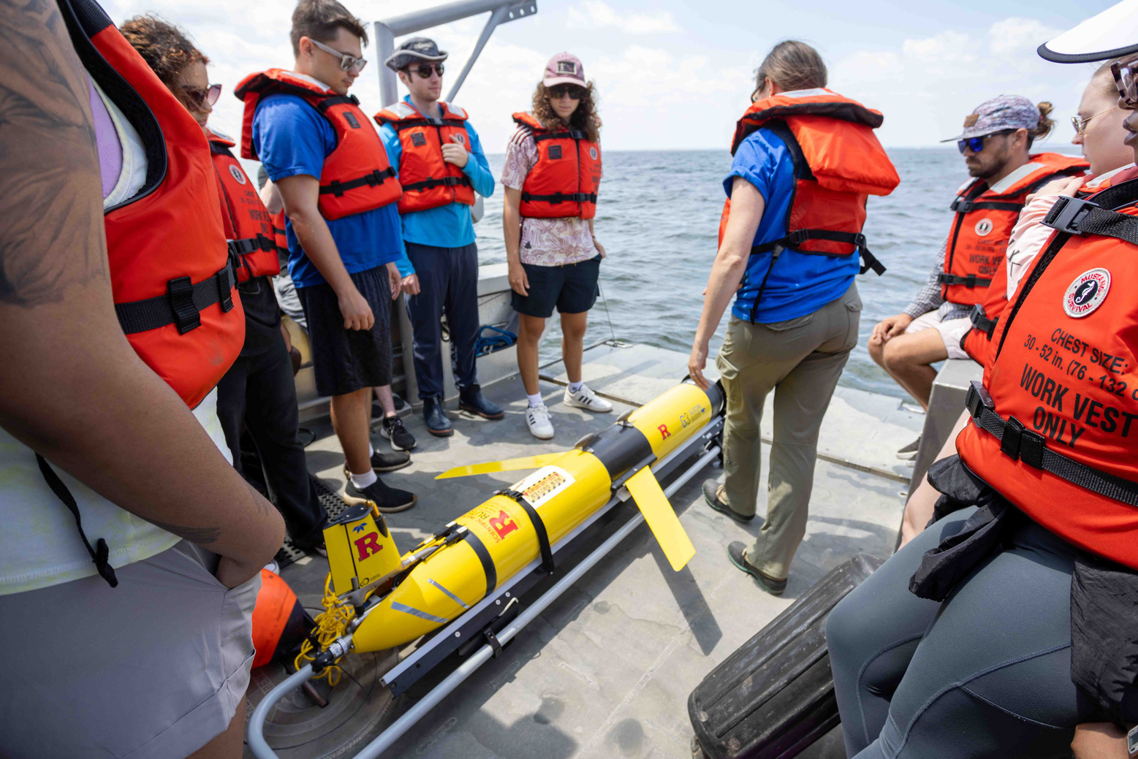
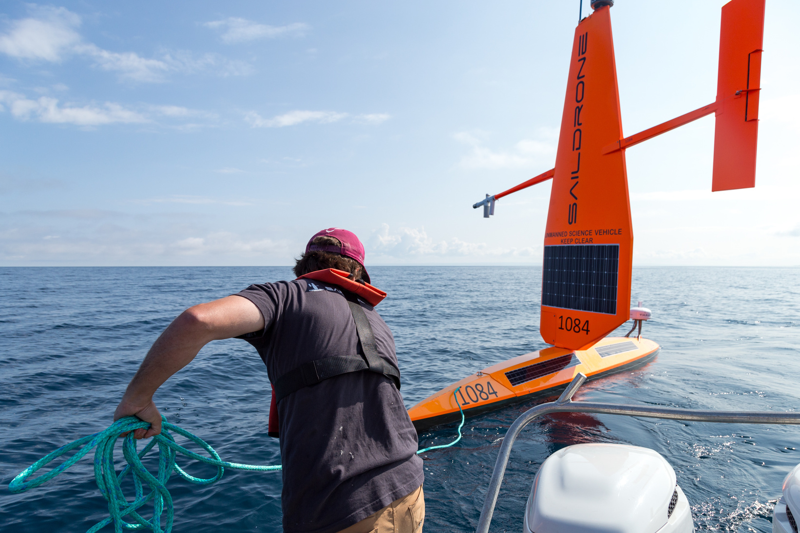



Accelerating Opportunities in the Ocean Marketplace
Improving the Marketplace
Cultivating Collaboration
Shaping the Future
Unlocking the ocean’s economic potential through better data and emerging markets.
Bridging public-private gaps to drive impact and innovation.
Investing in talent and infrastructure to sustain the ocean economy.
Interchange
Blue Workforce Convenings
Ocean Enterprise Accelerators
Standards and Best Practices
TechSurge Events
Dialogues w/ Industry
Harmful Algae Blooms
NSF Microcrodentials
Summer Workshops

